Slide 1

HR ANALYTICS
Employee Retention Dashboard
Group-4
Pari Lukka
Neha Patil
Sayali Salunkhe
Ankit Mishra
Sesh Arvind
Akansha Mohite

Slide 2
What is Employee Retention ?
Employee retention refers to the efforts a company makes to keep its employees happy and prevent them from leaving. It's the opposite of employee turnover, which is the rate at which employees leave a company.
Here are some reasons why employee retention is important:
Reduces costs: Recruiting and training new employees is expensive. By retaining current employees, companies can avoid these costs.
Improves productivity: Experienced employees are more productive than new hires.
Boosts morale: A high turnover rate can damage morale among remaining employees.

Slide 3


Employee Attrition
Employee attrition is the gradual reduction in employee numbers.
Employee attrition happens when the size of your workforce diminishes over time.
This means that employees are leaving faster than they are hired.
Types of Attrition:-
Voluntary:- Changing career or accepting a new job offer.
Involuntary:- Position elimination, termination or layoffs.
Retirement

Slide 4
Dataset Provided
Dataset Name: HR_1 & HR_2
Dataset Type: Excel Data
Dataset Size: 50k records each

Slide 5
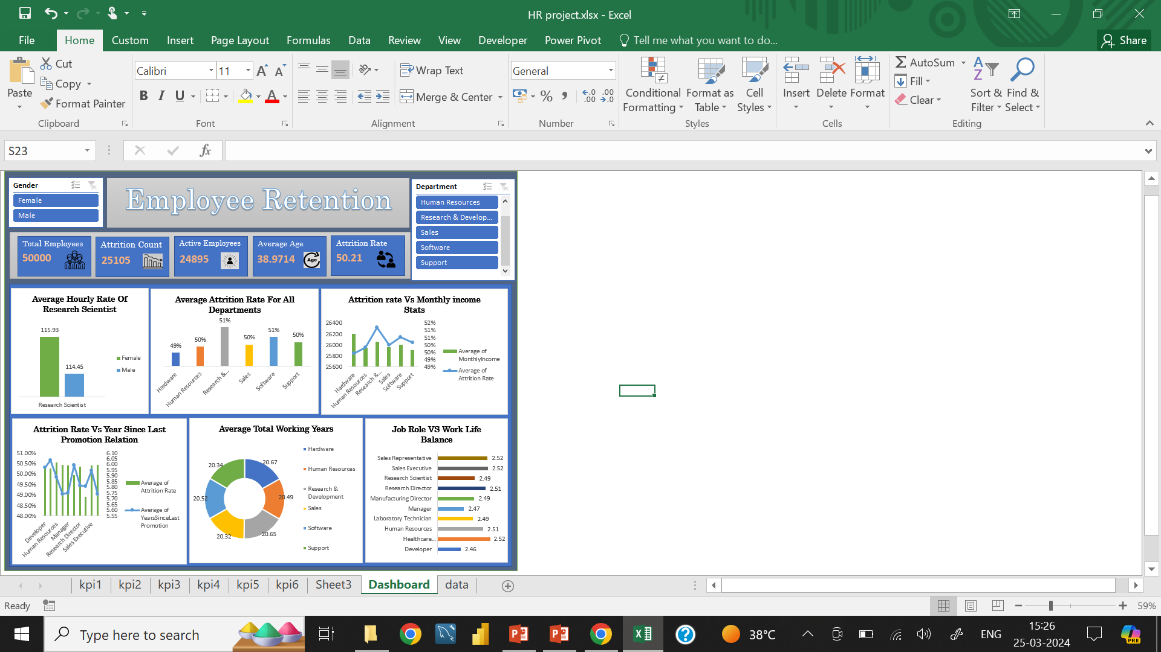
EXCEL DASHBOARD

Slide 6
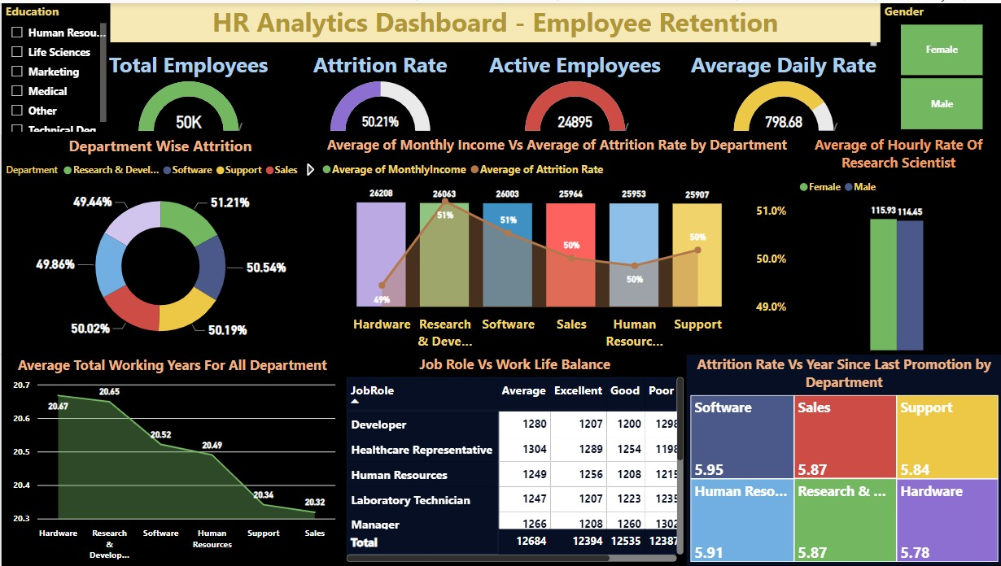
POWER BI DASHBOARD

Slide 7
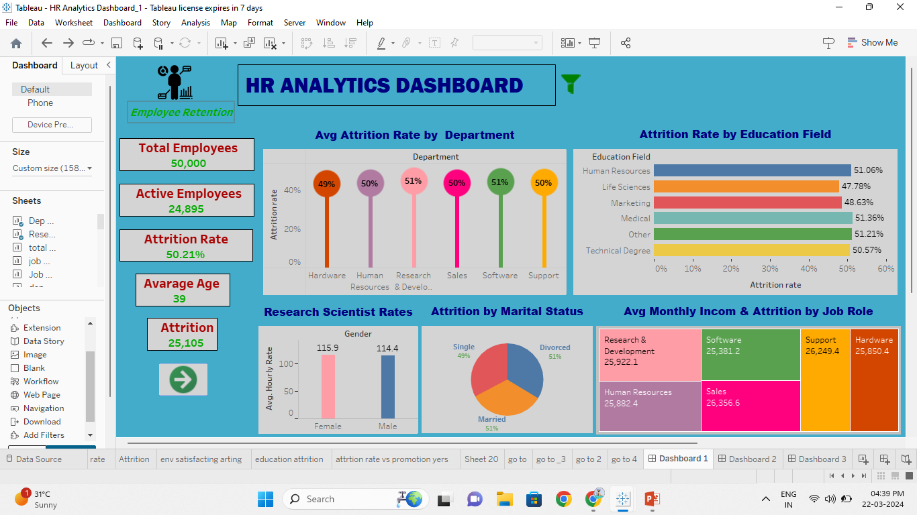
TABLEAU DASHBOARD

Slide 8
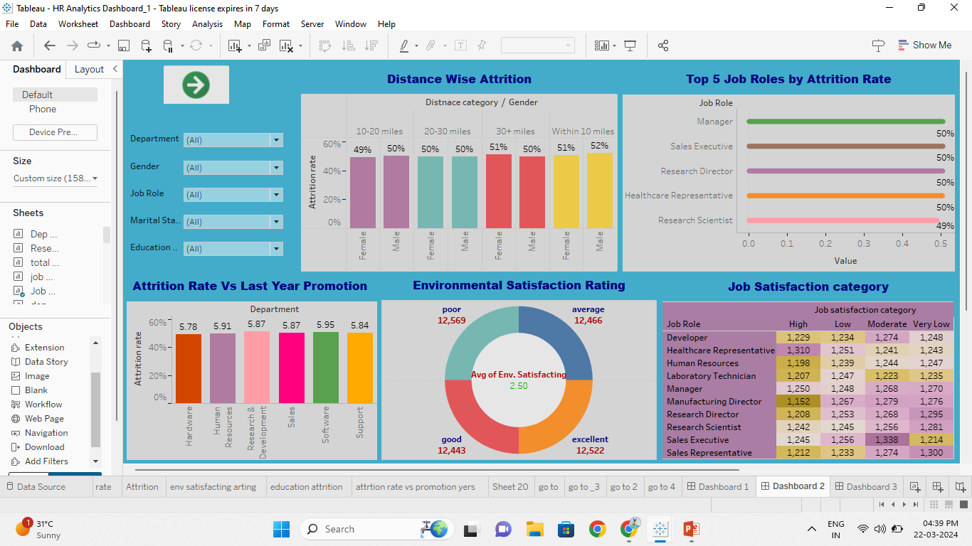
TABLEAU DASHBOARD

Slide 9
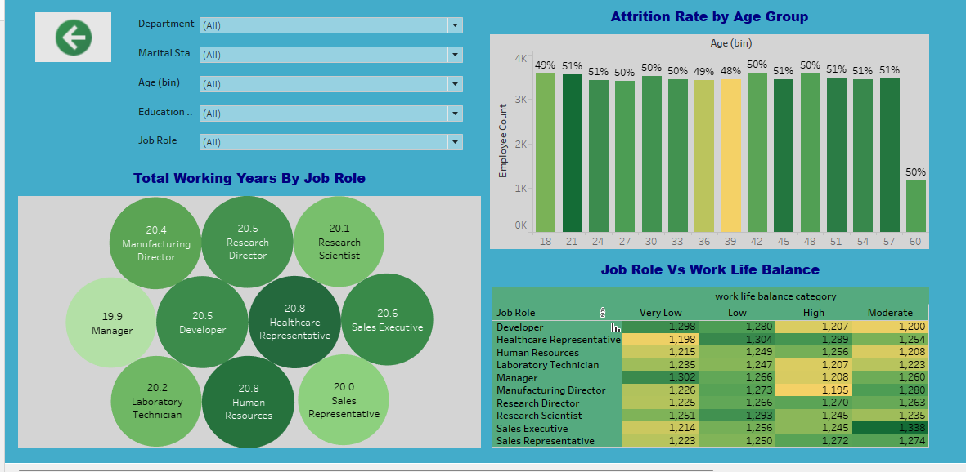
TABLEAU DASHBOARD

Slide 10
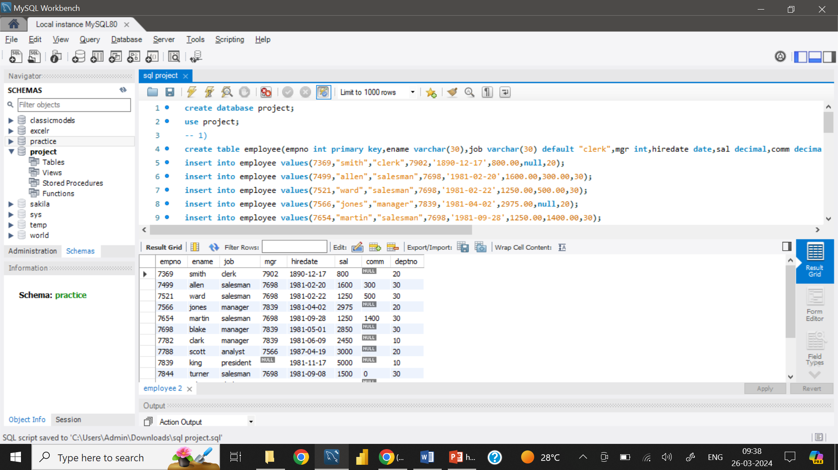
SQL QUERIES
1. Create the Employee Table as per the below data in the table:

Slide 11
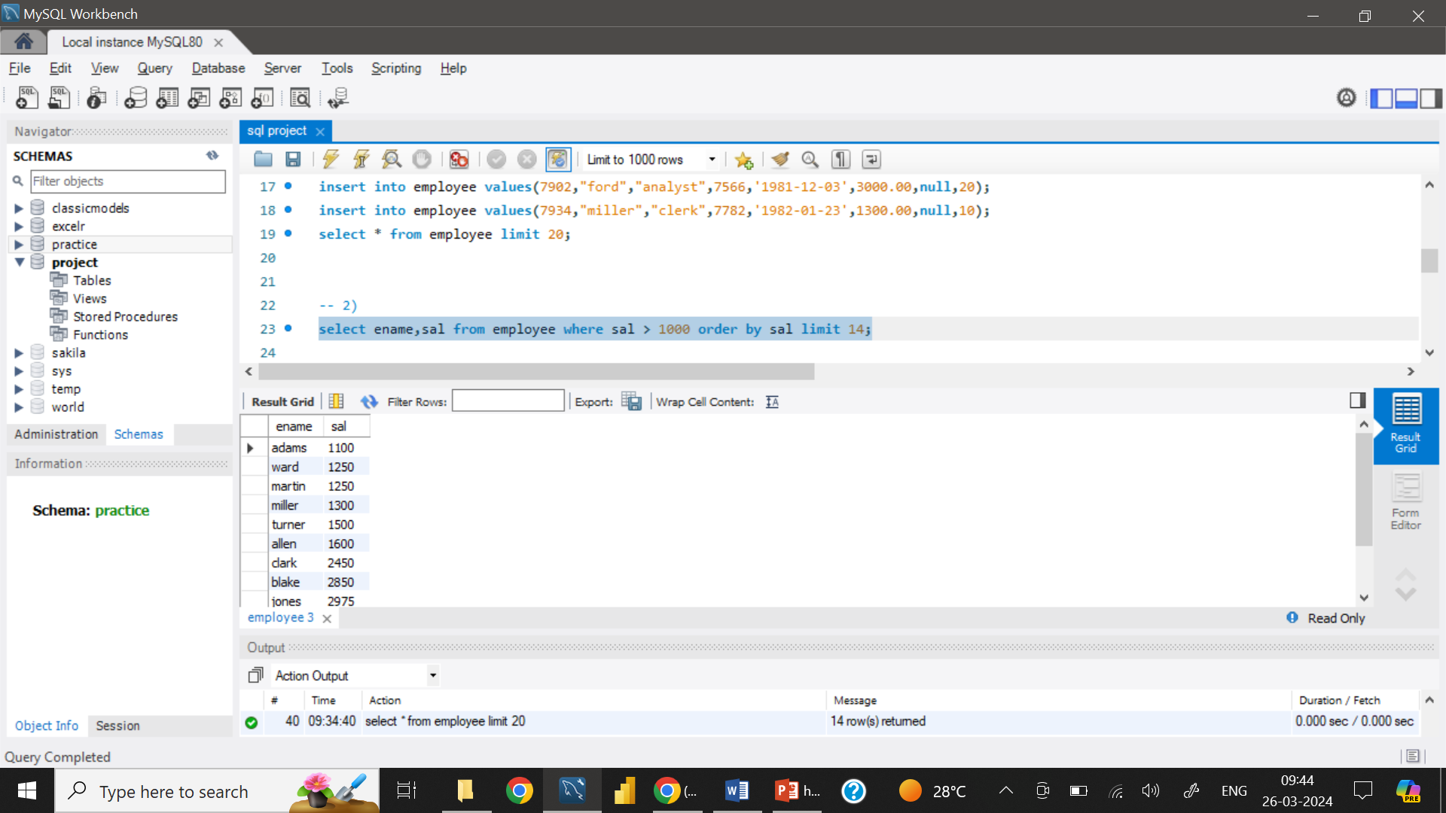
2. List the Names and salary of the employee whose salary is greater than 1000

Slide 12
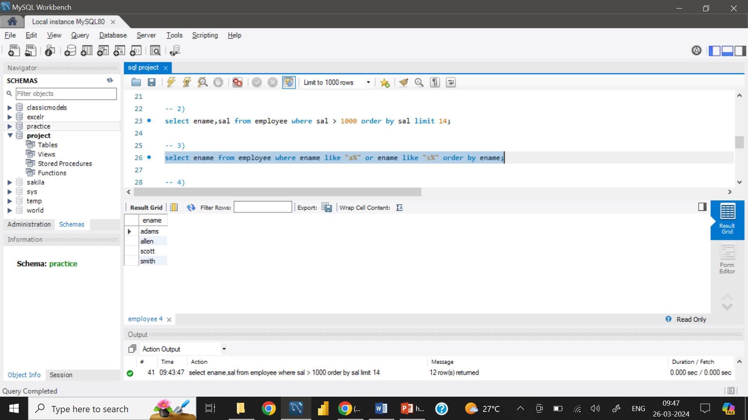
3. List Employee Names whose names start with either A or S.

Slide 13
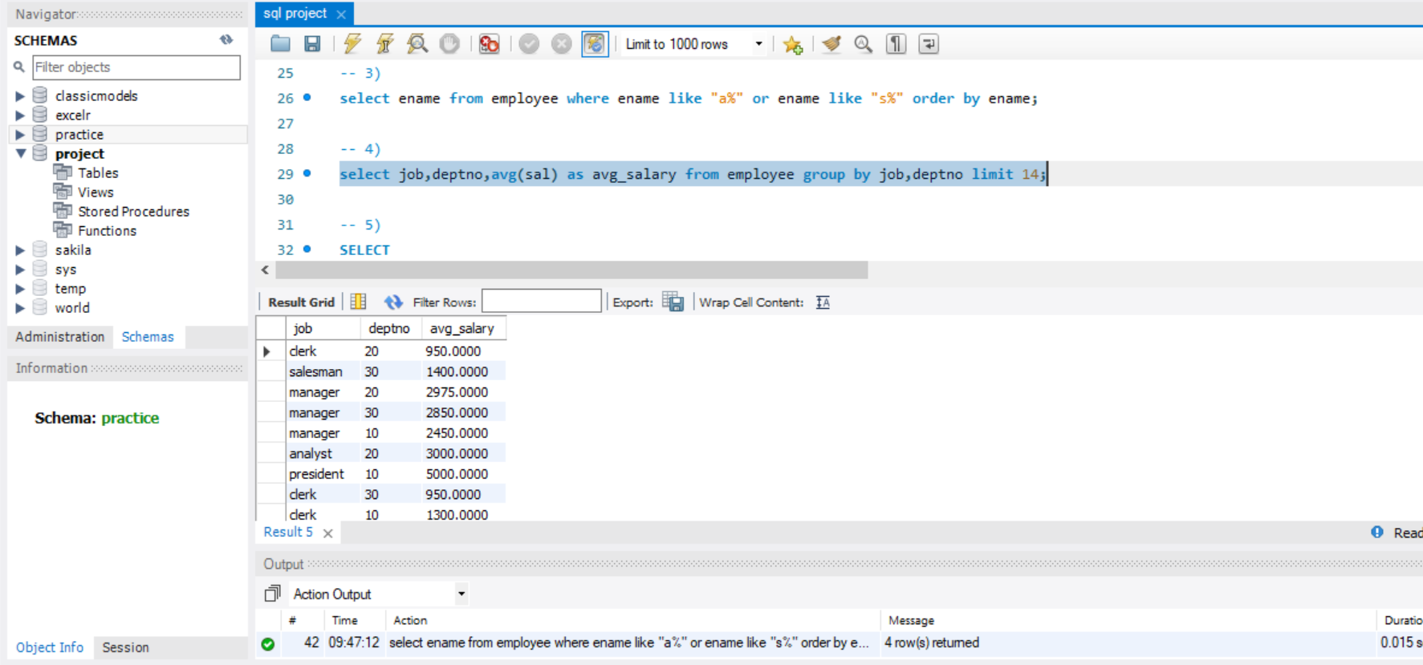
4. List average monthly salary for each job within each department

Slide 14
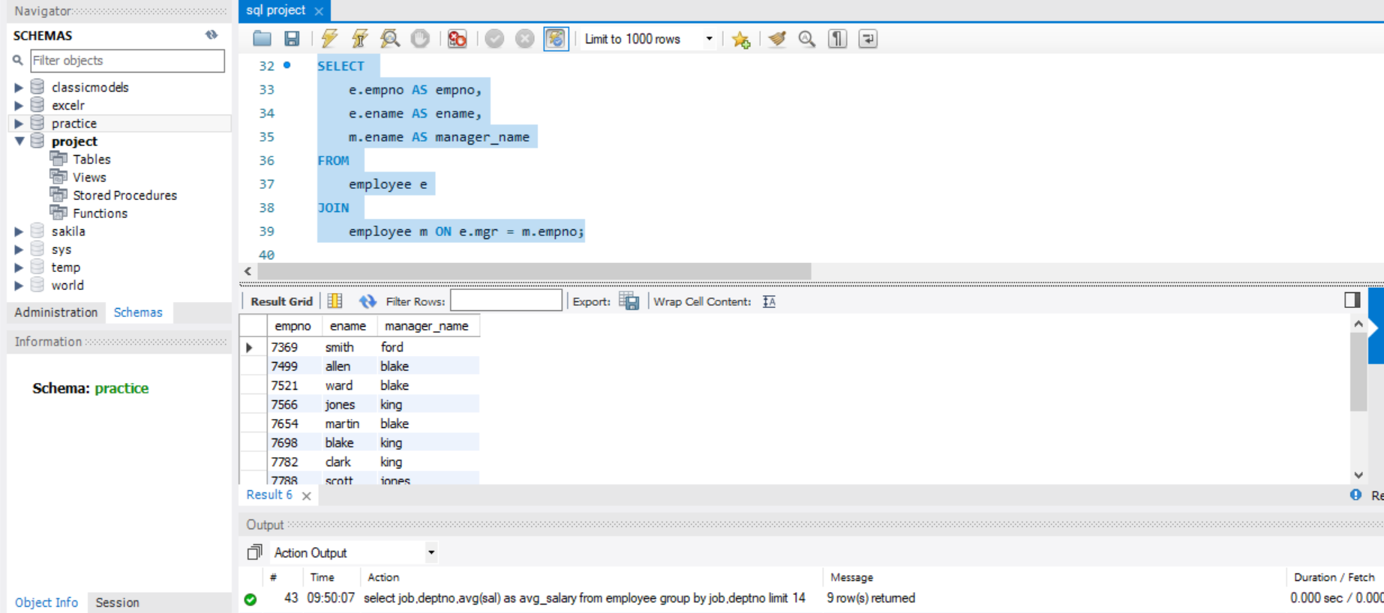
5. Display the empno, Emp name and the Manager name under whom the Employee works.

Slide 15
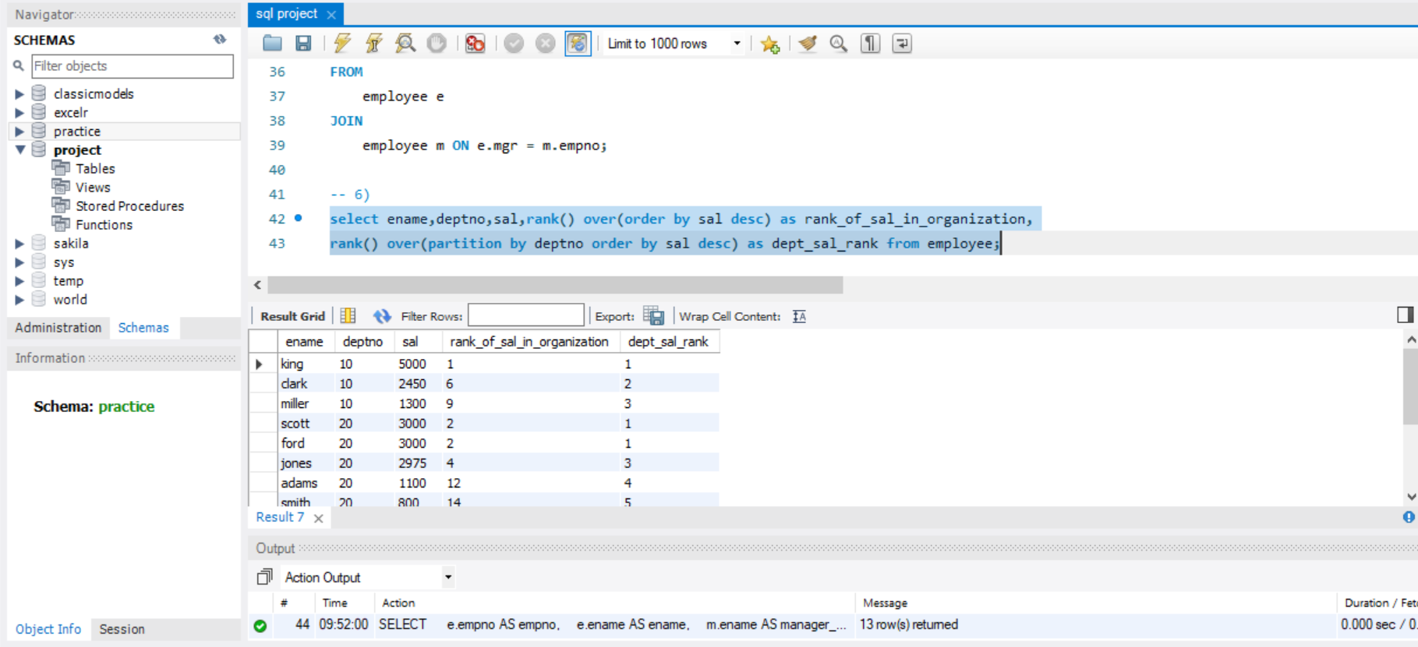
6. Display Empname, department no, salary , Rank of salary in Organisation , Rank of Salary in their respective department

Slide 16
KEY INSIGHTS
Total Employees: 50,000
Attrition Rate: 50.21%
Attrition Count: 25105
Average Age: 39 Years
Average Monthly Income: 26015.78
Average Years at Company: 10.77 Years

Slide 17
INSIGHTS
Department:-
Research and Development department is having the highest attrition rate of 51.21%.
Research and Development department has higher attrition of 52% for female employees.
Software department has a attrition of 52% for male employees.
Age:-
According to the analysis the age group of 21-24 and 51-57 is having the highest attrition of 51%.
Job Role:
From the analysis performed the top 5 high attrition roles are:
Manager, Sales Executive, Research Director, Healthcare Representative, Research Scientist.

Slide 18
INSIGHTS
Education:-
Employee having the education field as medical has the highest attrition of 51.36%.
Employee having life sciences as education field has the lowest attrition of 47.78%.
Environment Satisfaction and Job Satisfaction:-
The average environment satisfaction rating is 2.49 and average job satisfaction rating is 2.48.
Distance:-
From the analysis it was found that the attrition for male and female is 52% and 51% respectively within the distance of 10 miles.

Slide 19
CONCLUSION
Observing from the insights and dashboard it showcases important information about employees that can help make better decisions and keep employees happy and working for the organization.
By taking actions to address the issues that employees face and creating a positive work environment, the HR department can help employees perform better and stay in their jobs longer. This can help the organization make more money and be more successful.
Some of the ways to reduce attrition:-
Set realistic expectations.
Offer support and show appreciation.
Compensate fairly and recognize high performers.
Allow for a more flexible work schedule.
Making sure that the right people are in the right roles at the right team.

